Slide 1
An Introduction

Slide 2
What is Python?
Interpreted language
Created by Guido Van Rossum
early 90s
Named after Monty Python
www.python.org

Slide 3
Why use Python?
Rapid development
Clear & concise syntax
Tons of libraries
FOSS:
Free and Open Source Software
GPL compatible license

Slide 4
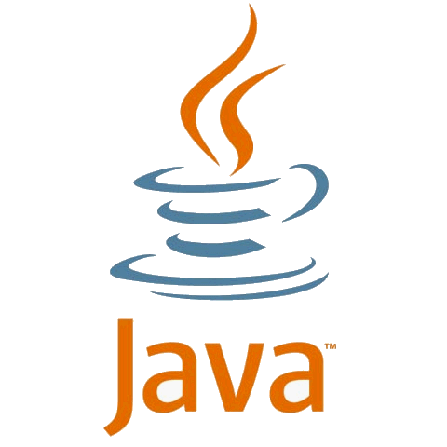
Why use Python?
Portability.
Linux
Windows
Mac
JVM
.Net
Etc.

Slide 5
Why not Python
Performance critical applications
Realtime systems
Scientific computations
issues with multi-threading
no static type verification for large projects

Slide 6
Versions
Python version 3.*
Not backwards compatible with 2.*
We’ll learn 2.*

Slide 7
Hello World
Observations
Semicolons not needed
Strings can be in single or double quotes
a = 'hello' b = "world" print a, b

Slide 8
Basic Types
observations?
dynamic typing
a = 13 # integer literals b = 0xbeef # hex literals a = 5.5 # float literals b = True # boolean types: True, False a = None # python's null type del a # a is no longer defined b = 'str' # a string

Slide 9
Numbers
Supports the usual operators (except ++, --)
Built-in Bignums
a = 4 b = 5.2 print a + b # 9.2
b = 2 ** 100 # exponentiation
print b #1267650600228229401496703205376L

Slide 10
Strings
use single or double quotes
use + for Concatenation
triple quotes preserve formatting
a = r"raw \t string\n" print a # raw \t string\n
a = ''' triple
quotes'''

Slide 11
Strings
what is the result of
'nana nana nana Batman!'
a = "Batman!" b = 'nana ' print b*3 + a

Slide 12
conversions
a = 20 b = 12 print str(a) + str(b) # 2012
a = '2000' b = '12.0' print int(a) + float(b) # 2012.0

Slide 13
Branching
a = True if a: print 'a is True'
# a is True
boolean types: True, False
mandatory indentation
can use spaces or tabs
must be consistent

Slide 14
Boolean Operators
boolean operators:
and, or, not, >,<,==, >=, <=
b = 5 if b < 3 or b > 10: pass # pass allows empty blocks elif b >= 4 and b < 7: print 'found' else: print 'none'

Slide 15
Data Structures
Lists
Dictionaries
Sets
Tuples

Slide 16
Lists
mylist = [1, 2,'three',4,'five'] print mylist[1] # 2 print len(mylist) # 5 print mylist[2:4] # ['three',4]
print mylist.pop() # 'five' print mylist.pop(0) # 1 print mylist # [2,'three',4] mylist.append(5) # same as mylist += [5]
what is mylist[1:3] + [mylist[0]]?
['three',4,2]

Slide 17
Dictionaries
what is the result of print d['all'][2]
3
d = {1:'one', 'two':2, 'all':[1,2,3]} print d[1] # one print d['two'] # 2
print d[99] # KeyError
if 99 in d: # checks for a key print d[99]

Slide 18
Tuples
like anonymous immutable structs
t = ('str', 5, False) print t[2] # False t[1] = 9 # error, cannot assign a,b,c = t # multiple assignment print b # 5

Slide 19
looping
for-loops and while-loops
break and continue
# print all digits: for i in range(10): print i i = 0 while True: if i > 5: break i += 1

Slide 20
iterating over data
squares = [i*i for i in range(10)] for square in squares: print square
d = {'1':1,'2':2,'3':3} for val in sorted(d.values()): print val
quicky create data with list comprehensions:
"expr for var in iterable"
iterate over data with "for … in …"

Slide 21
iterating over data
what is the result?
[1,3,5,7,9]
mylist = [i for i in range(10) if i % 2 == 1] print mylist

Slide 22
functions
use the 'def' keyword
return type is inferred
supports default parameters
def greet(name='stranger'): print 'hello', name greet('Guido') # hello Guido greet() # hello stranger

Slide 23
functions
def make_adder(op1=1): def adder(op2): return op1 + op2 return adder myfunc = make_adder(5) myfunc(4)
first-class functions and closures
what is the result of myfunc(4)?
9

Slide 24
Lambdas
lambdas are anonymous functions
what would be the result of
filter(lambda x: True, mylist)
[]
mylist = [1,2,3,4,5,6,7,8,9] evens = filter(lambda x: x%2 == 0, mylist) print evens # [2,4,6,8]

Slide 25
Generators
def powers_of_2(limit): x = 1 for i in range(limit): yield x x *= 2 mylist = [i for i in powers_of_2(10)]
what is the value of mylist?
[1, 2, 4, 8, 16, 32, 64, 128, 256, 512]

Slide 26
Global Scope
globals variables
ok to access in nested scope
must declare as global to modify
x,y,z = 0,0,0 # global vars
def foo():
global x
x += 1 # ok print y # ok z += 1 # error!

Slide 27
Imports
import to use objects and functions from another file.
a.py
b.py
def foo(): pass def bar(): pass
import a from a import bar a.foo() bar()

Slide 28
Imports
import:
loads types from another module on the path.
from … import:
directly imports only the specified type.
import math from math import sqrt print sqrt(16) # ok print cos(0) # error print math.cos(0) # ok

Slide 29
Exception Handling
use except to catch exceptions
use raise to throw an exception
try: raise NameError('oops') except NameError as e: print 'error: ', e except: print 'some other error'

Slide 30
Exception Handling
else is optional. runs if no exception happens.
finally is optional. always runs.
def divide(x, y):
try:
result = x/y
except ZeroDivisionError:
print "who divided by zero?"
else:
print "result is", result
finally:
print "finally"

Slide 31
Example File IO
reading a file by line is super easy.
file handles can iterate over the lines of a file.
f = open('file.txt', 'r') for line in f: print line f.close()

Slide 32
Example File IO
another (better) way to do the same thing:
use with to manage resources.
simpler than try … finally.
with open('file.txt', 'r') as f: for line in f: print line print f.closed # True

Slide 33
More File operations
with open('file.txt', 'rP') as f: line = f.readline() # read a line
block = f.read(1024) # read the next 1024 bytes
f.seek(0) # go to the 1st byte all = f.read() # read all the bytes f.write('LOL!!!11') # write a string to the file

Slide 34
CLasses
python supports OOP.
all methods are public and virtual.
supports multiple inheritance.

Slide 35
Classes
declare classes using the class keyword
1st parameter of methods is always the self reference.
class Adder: def add(self, op1, op2): return op1 + op2 a = Adder() print a.add(1,5) # 6

Slide 36
Classes
class Counter: def __init__(self, x): self.x = x
def inc(self): self.x += 1 c = Counter(0) print c.x # 0
c.inc()
print c.x # 1

Slide 37
Interpreter
The Python interactive interpreter
use to learn
use to debug
use as calculator
>>> i = 0 >>> while i < 5: ... print i ... i += 1 ... 0 1 2 3 4 >>>

