Slide 1
Google Maps API

Slide 2
Static Maps
send an HTTP GET request
receive an image (PNG, GIF, JPEG)
no javascript needed
encode params in URL
example:
http://maps.googleapis.com/maps/api/staticmap?param1=val1&param2=val2 ...

Slide 3
Static Maps
embed using the "src" attribute of the <img> tag.
some parameters:
cetner: "lat,long" or "string address"
zoom, size, scale
path, markers
sensor

Slide 4
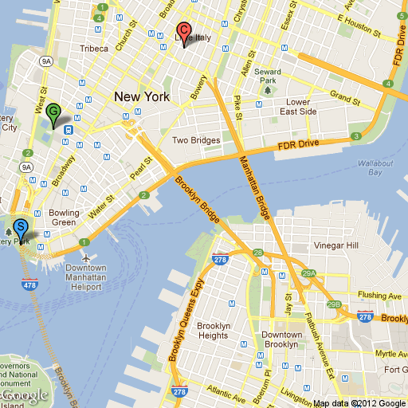
Static Maps
http://maps.googleapis.com/maps/api/staticmap?center=Brooklyn+Bridge,New+York,NY&zoom=14&size=512x512&maptype=roadmap &markers=color:blue%7Clabel:S%7C40.702147,-74.015794&markers=color:green%7Clabel:G%7C40.711614,-74.012318 &markers=color:red%7Ccolor:red%7Clabel:C%7C40.718217,-73.998284&sensor=false

Slide 5
Static Maps
Documentation:
https://developers.google.com/maps/documentation/staticmaps/

Slide 6
Javscript API
embed Google Maps in web pages.
provides functions to manipulate maps
free
new: API key optional
https://developers.google.com/maps/documentation/javascript/

Slide 7
Javscript API
reference the API libraries in the <head>
embed the map canvas in the web page:
<script type="text/javascript"
src="http://maps.googleapis.com/maps/api/js?&sensor=false">
</script>
<div id="map_canvas"></div>

Slide 8
Loading the API
Browser must load Maps API (js code) from Google.
client code should not run until after the API has finished loading.
e.g. if you call the API functions in initialize:
<body onload="initialize()">
<div id="map_canvas"></div>
</body>

Slide 9
A Simple Map
a map object takes an html element and an options object:
var map = new google.maps.Map(
document.getElementById("map_canvas"),
myOptions
);

Slide 10
A Simple Map
myOptions is a JS object, specified using JSON:
where location is a LatLng object:
many more options are available
var myOptions = {
center: location,
zoom: 12,
mapTypeId: google.maps.MapTypeId.ROADMAP
};
var location = new google.maps.LatLng(40.4, -79.9);

Slide 11
A Simple Map
a LatLng object specifies a location:
and the map type can be:
google.maps.MapTypeId.ROADMAP
google.maps.MapTypeId.TERRAIN
google.maps.MapTypeId.SATELLITE
var location = new google.maps.LatLng(40.4, -79.9);

Slide 12
Create a Map
full code listing:
function initialize() {
var location = new google.maps.LatLng(40.4, -79.9);
var myOptions = {
center: location,
zoom: 12,
mapTypeId: google.maps.MapTypeId.ROADMAP
};
var map = new google.maps.Map(
document.getElementById("map_canvas"),
myOptions
);
}

Slide 13
Placing Markers
markers indicate points of interest
marker options specify: location, icon, etc.
set the marker using setMap()
var options = {
position: new google.maps.LatLng(-27.463347, 153.02496)
};
var marker = new google.maps.Marker(options);
marker.setMap(map); // set the marker on the map

Slide 14
Interactive Maps
you can add event handlers to the map:
example: show the (lat,lng) when the user clicks on the map.
// in the init function():
google.maps.event.addListener(map, 'click', onMapClick);
function onMapClick(details) {
alert(details.latLng);
}

Slide 15
Street View
function initialize() {
var myOptions = {
position: new google.maps.LatLng(40.44285, -79.952960),
pov: {
heading: 0.0,
pitch: 20,
zoom: 1
}
};
var pano = new google.maps.StreetViewPanorama(
document.getElementById('map_canvas'),
myOptions);
}

Slide 16
Geocoding & reverse Geocoding
convert an address to (lat,lng)
var geocoder = new google.maps.Geocoder();
var request = { address: "48 Pirrama Rd, Pyrmont" };
geocoder.geocode(request, function(results, status) {
if (status == google.maps.GeocoderStatus.OK) {
// center map on location ...
} else {
// log error to console ...
}
});

Slide 17
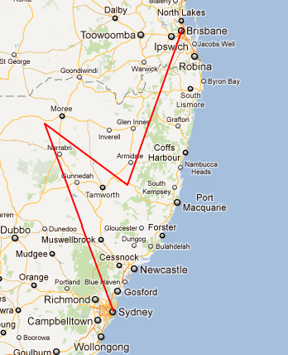
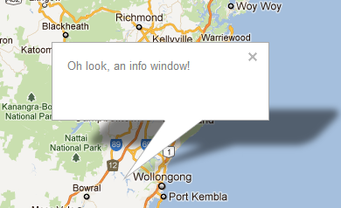
Not covered
other things you can do:
animate markers
markers in street view
info windows
elevation
directions
shapes & lines

